Slide 1
Understanding of SPOT communication
Niraj Kishor Ladhe
Abhishek Dilip Patil

Slide 2
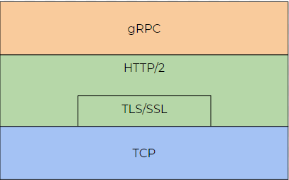
RPC (Remote Procedure Call)

Slide 3
gRPC
The open source RPC framework developed by google.
The clients and the server are connected using this framework
In our case, the SPOT robot is the server and the client can be either the tablet or any connected PC.
Protocol buffers are used to communicate. Protocol Buffers are a language-neutral, platform-neutral extensible mechanism for serializing structured data._{[5]} Google’s mature open source mechanism for serializing structured data._{[3]}
The protocol buffers are defined using “.proto” extension definition files. The structure for the data is defined in this file. _{[3]}
A protocol buffer compiler (protoc) generates data access classes in your preferred language(s) from your proto definition._{[3]}

Slide 4
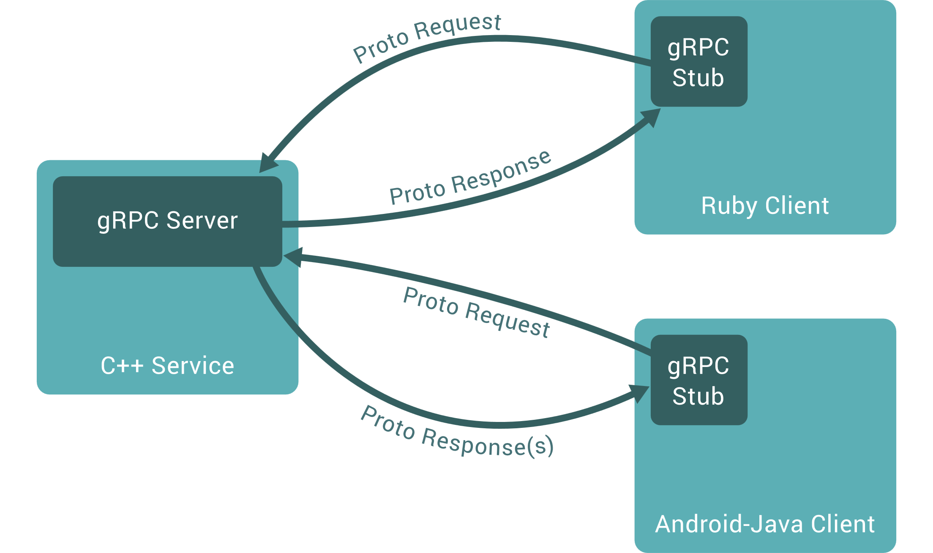
RPC (Remote Procedure Call)

Slide 5
gRPC Service definition_{[4]}
gRPC has four kinds of service methods:
Unary RPCs where the client sends a single request to the server and gets a single response back, just like a normal function call.
Server streaming RPCs where the client sends a request to the server and gets a stream to read a sequence of messages back. The client reads from the returned stream until there are no more messages. gRPC guarantees message ordering within an individual RPC call.
Client streaming RPCs where the client writes a sequence of messages and sends them to the server, again using a provided stream. Once the client has finished writing the messages, it waits for the server to read them and return its response. Again gRPC guarantees message ordering within an individual RPC call.
Bidirectional streaming RPCs where both sides send a sequence of messages using a read-write stream. The two streams operate independently, so clients and servers can read and write in whatever order they like: for example, the server could wait to receive all the client messages before writing its responses, or it could alternately read a message then write a message, or some other combination of reads and writes. The order of messages in each stream is preserved.

Slide 6
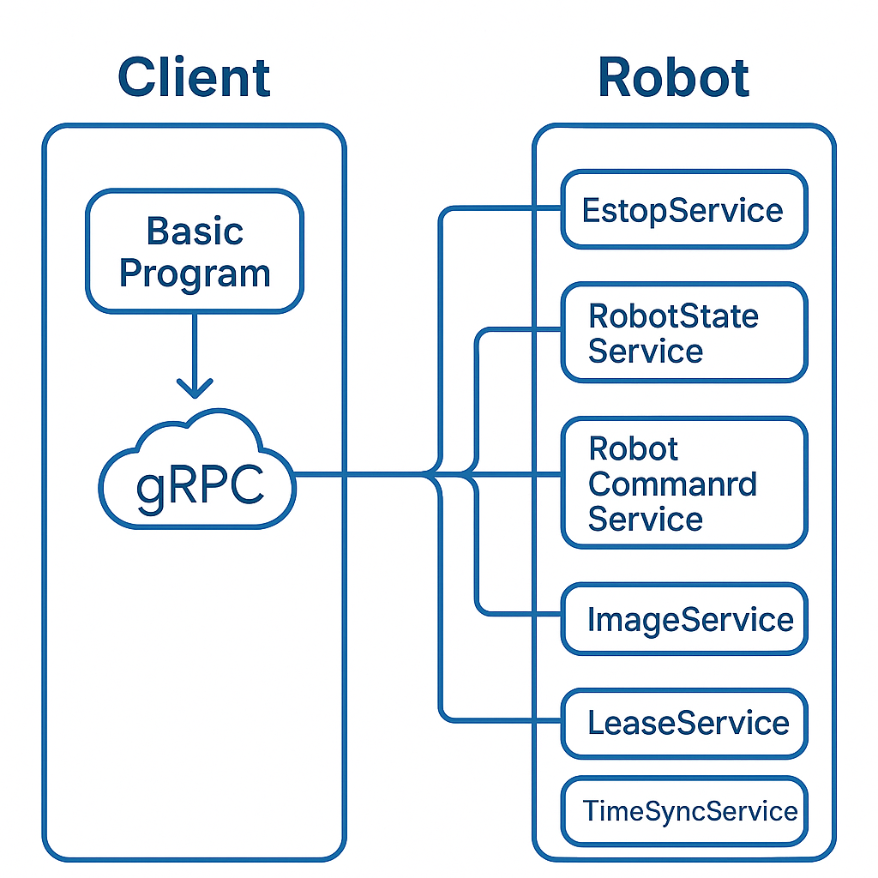
Basic Programme

Slide 7
Robot services_{[1]}
gRPC specifies the service interfaces and remote procedure calls (RPCs) supported by the service. For example, the Spot API has an authentication service to check the passed in username and password and returns a session token if they are valid._{[2]}
Services used in the basic program:
Base services: robot-id, auth, estop, time-sync, lease, robot state service, keep alive.
Other services: basic command (contains basic commands like sit or stand), image services.

Slide 8
Basic Programme
The basic programme mostly uses the base services required to keep the connection from breaking from a client.
The other services are to either make the robot stand or sit and also take an image.
All of these services are called to perform a specific action that belongs to that service. For e.g. Taking or leaving the lease belongs to the lease service.
Most of the base actions performed in the programme are supported by the services. It ranges from estop to making the robot stand and sit.
For the display of image, the image capture is part of the service, although the code to display or save the image is only at the client end.

Slide 9
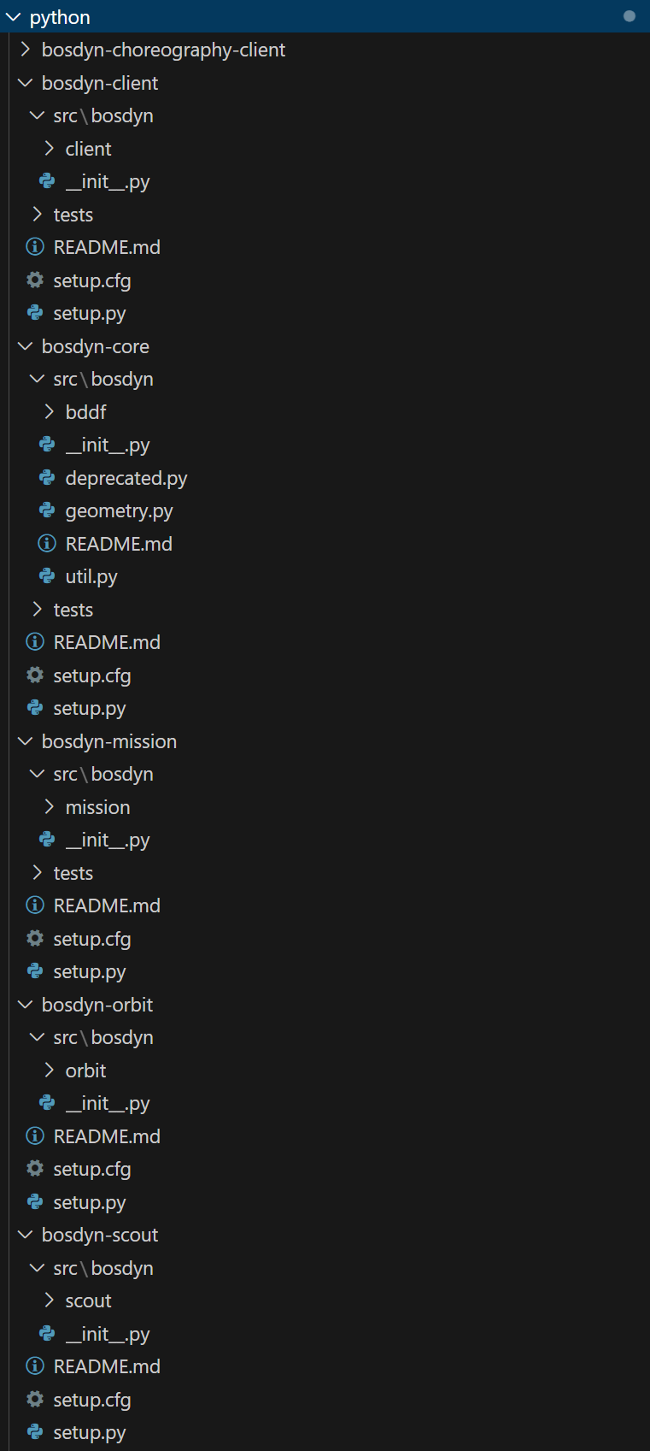
General understanding of how the sample programs work
All the packages needed to run the SDK and the RPC buffers must be downloaded by referring the SPOT SDK – SPOT documentation.
SDK requires python code generated from original proto files with the help of protobuf compiler. As proto files only contains definitions in language-neutral format, this python code generated by the compiler has the logic for serialization/deserialization of the logic which converts Python objects to protobuf binary format and vice versa.
The Python code in the “src” folder of each concept of SPOT imports the compiled python code of protobuf compiler. Then the classes or the objects in these files are called in the sample programs. For e.g. For using commands falling in bosdyn-client which vary from “autowalk”, image retrieval to “lease” and “robot_id commands”, one calls the definitions/functions from these python files to use those services.
The “_pb2.py” are the files which are generated using protobuf compiler. THESE FILES SHOULD NOT BE EDITED! But there can be a exception if a new “.proto” file is created by the user, then a new “_pb2.py” is needed to be complied to be used with the SDK.

Slide 10
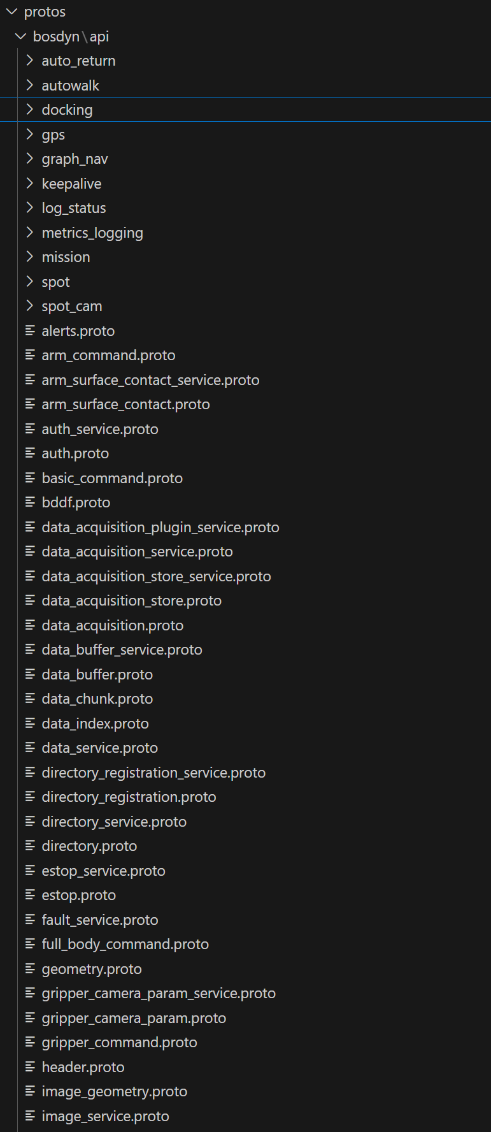
Storage of the different file formats
The “_pb2.py” files are downloaded while installing the SPOT python packages and they are stored locally on the PC.
The “.proto” definition files are made available in the SDK.
The definition files are not used in real time when running the code. The generated python files are used.

Slide 11
Flow chart of the process at the client end
User program
SDK python files
“…_pb2.py” files in the python package generated using the protobuf complier
Sending and receiving data from SPOT

Slide 12
Core I/O _{[6]}
Core I/O has read-only root filesystem. But it has read-write partitions for user data and applications.
However the attempts made to connect to Core I/O via SSH were unsuccessful. Still a docker file is created to better understand the working.

Slide 13
Git repository link:
https://github.com/abhishekdilippatil/spot-sdk.git

Slide 14
References:
SPOT SDK – SPOT documentation https://dev.bostondynamics.com/docs/concepts/robot_services [1] https://dev.bostondynamics.com/docs/concepts/networking [2] https://dev.bostondynamics.com/docs/payload/coreio_documentation [6]
gRPC website https://grpc.io/docs/what-is-grpc/introduction [3] https://grpc.io/docs/what-is-grpc/core-concepts [4]
https://protobuf.dev/overview [5]

